Slide 1



Mini Project 1
STOCK MARKET PRICE ANALYSIS AND PREDICTION
BASED ON TWITTER DATA

Slide 2

The idea of the project is that it helps a stock seller or buyer by comparing best stock markets and giving the future prediction and help them if to sell or buy the stock
STOCK MARKET PRICE ANALYSIS AND PREDICTION
BASED ON TWITTER DATA

Slide 3


INTRODUCTION
Objective: Build model to predict the Future stocks of multiple companies and help the stock buyer or the stock seller.
The Power of Sentiment Analysis:
Sentiment analysis allows us to determine the sentiment expressed in tweets, whether positive, negative, or neutral.
By combining sentiment analysis with stock market data, we can uncover correlations between sentiment and stock price movements.
Extracting Relevant Features from Twitter Data:
Features such as the number of mentions of specific stocks, trending hashtags, or sentiment scores can be extracted from Twitter data.
These features serve as inputs to machine learning models, enabling us to make predictions about future stock market prices.

Slide 4



INTRODUCTION cont...
Importance of Social Media in Stock Market Analysis:
1)Social media platforms, such as Twitter, have become valuable sources of real-time information and market sentiment.
2)Analyzing social media data can provide insights into investor sentiment, market trends, and potential stock price movements.
Leveraging Twitter Data for Stock Market Analysis:
Twitter data offers a vast amount of user-generated content that can be harnessed to understand market sentiment and predict stock market prices.
By analyzing tweets related to specific companies or keywords, we can gain valuable insights into investor opinions and market trends.
Enhancing Investment Decision-Making:
By incorporating Twitter data into stock market analysis, we can enhance investment decision-making by gaining a deeper understanding of market sentiment and potential price movements.
This approach can help investors make more informed decisions, manage risks, and potentially improve investment returns.

Slide 5
OVERVIEW
SUPERVISED LEARNING BASED 1)we have collected historical stock datasets for google, infosys, tesla, facebook stock market companies initially we have analized the stock market dataset for individual companies.
2)we have compared the performance analysis between the stock market companies and showing which company is better based on R-square and accuracy.
3)by collecting some twitter data on these companies only we discribed which company is trend on twitter based on number of likes, retweets and hashtag mentioned per year.
4)finally by image pre-processing we collected graphs of the stock trend companies and by collecting the data points from that we will be predicting the future trend based on the historical data.

Slide 6


Real-Time Market Insights:
Traditional stock market analysis relies on historical data and financial indicators, which may not capture real-time market sentiment.
Enhanced Predictive Models:Integrating Twitter data into stock market analysis allows us to leverage the collective wisdom of the crowd.
Uncovering Hidden Patterns and Market Influencers:Twitter data provides a wealth of information about market sentiment, opinions, and discussions related to specific stocks or market events.
MOTIVATION/SIGNIFICANCE

Slide 7
Challenges
Data Noise and Quality:data can be noisy and contain irrelevant or misleading information, making it challenging to extract meaningful insights.
Sentiment Analysis Accuracy:Sentiment analysis algorithms may not always accurately capture the nuanced sentiment expressed in tweets.
Data Volume and Scalability:Dataset can generates a massive volume of data, making it challenging to process and analyze in real-time.
Market Volatility and Uncertainty: The stock market is inherently volatile and influenced by various factors, including global events, economic indicators, and investor sentiment.
Model Generalization and Adaptability:Building a machine learning model that can generalize well across different market conditions and adapt to changing trends is a challenge.

Slide 8

DATASET DESCRIPTION
The dataset contains stock market information for multiple companies, including Facebook, Google, Infosys, and Tesla.
Each entry in the dataset represents a daily record of stock market data, including the date, opening price, highest price, lowest price, closing price, adjusted closing price, and trading volume.
The dataset provides a historical perspective, allowing for analysis of stock market trends and patterns over a specific period of time.
In addition to stock market data, the dataset includes Twitter data related to each company, such as tweet IDs, usernames, tweet text, retweets, likes, timestamps, company associations, and hashtags.
The Twitter data provides insights into market sentiment, opinions, and discussions related to the respective companies.

Slide 9

The dataset allows for the correlation and analysis of stock market performance with Twitter sentiment and other relevant features.
It enables the exploration of the relationship between social media activity and stock market movements.
The dataset can be used to train machine learning models for stock market price analysis and prediction.
It provides a valuable resource for evaluating the effectiveness and accuracy of the developed models.
The dataset can be further enhanced by incorporating additional features or sentiment analysis techniques to improve the predictive capabilities of the models.
DATASET DISCRIPTION

Slide 10

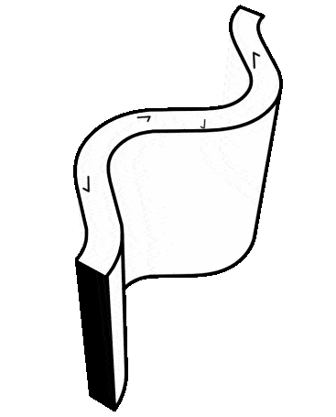
Linear Regression
Logistic Regression
ALGORITHMS USED
Decision Tree
SVM
KNN
NAIVE BAYES
Gradient Descent
OLS
Random
Forest

Slide 11
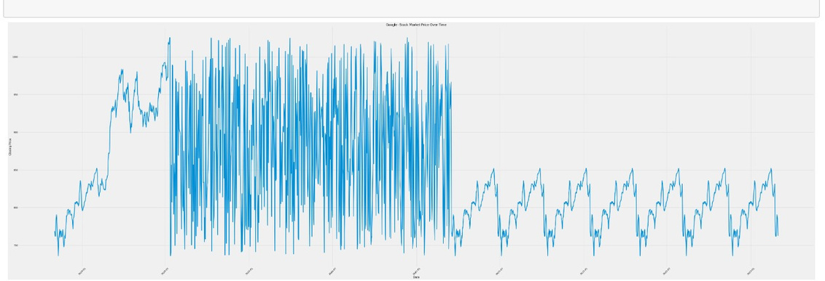
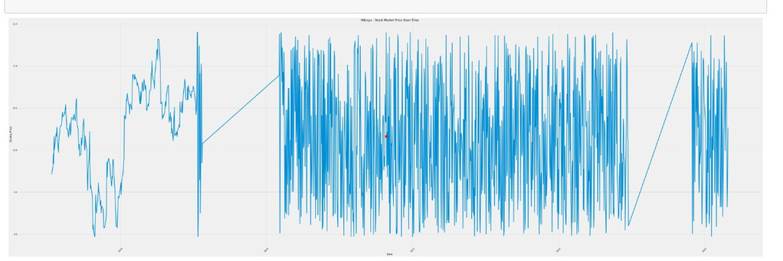
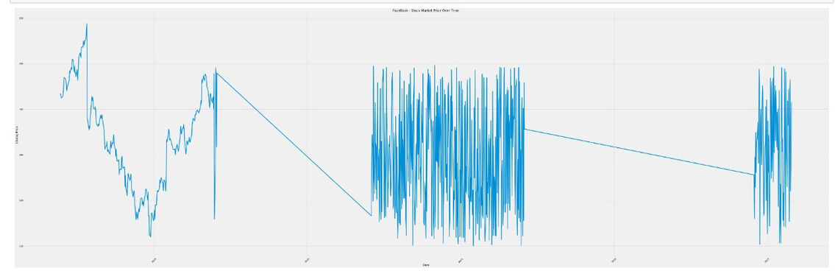
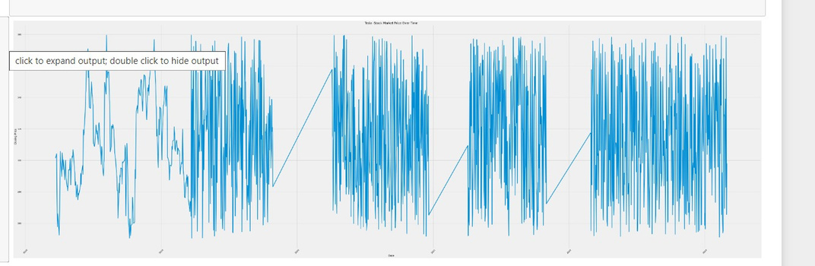
Result Comparison

Slide 12
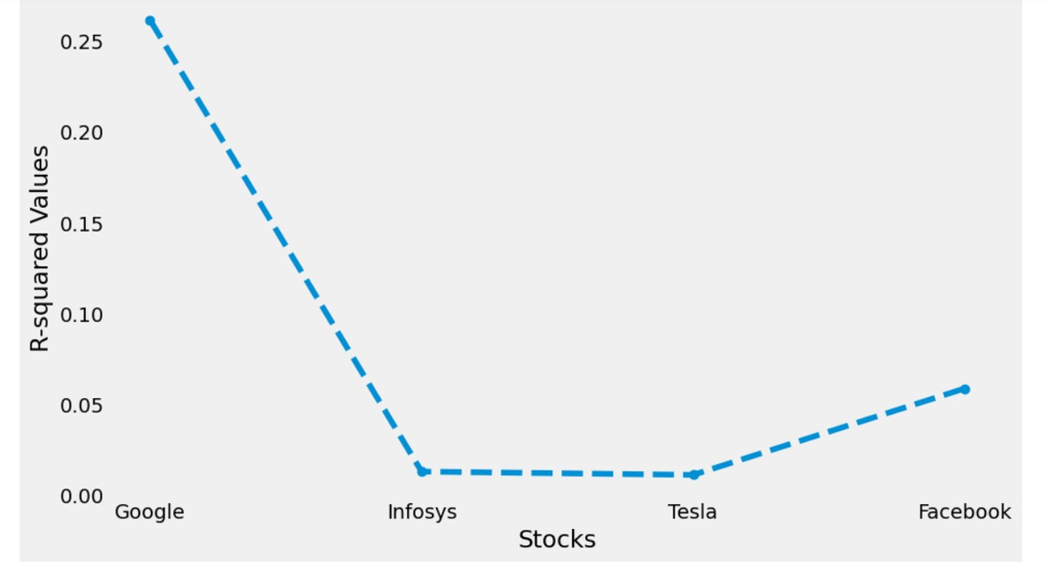
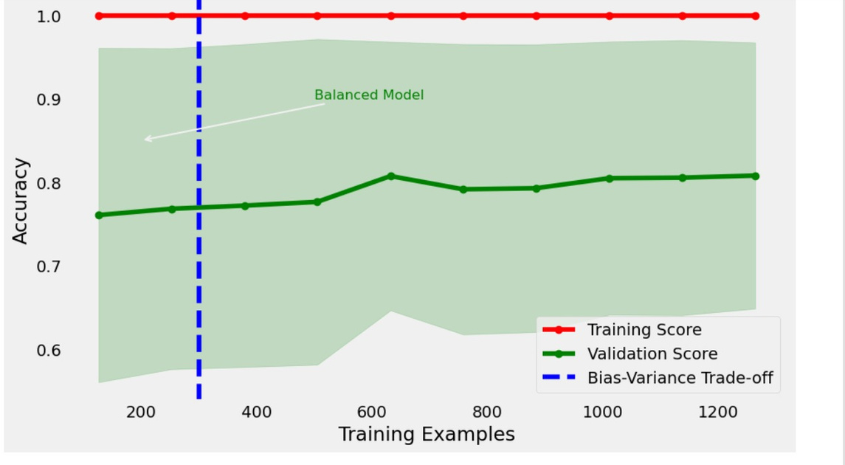
RESULT cont..
Based on the experiments that have been carried out, there are several models that are good for determining the views of YouTube videos
•Random Forest with MAE 0.76, RMSE 0.64, and R2 of 0.26 makes Random Forest the best model so far
• Decision Tree is the second best sequence model after Random Forest with a slightly smaller R2 value of 0.04

Slide 13


https://www.google.com/finance/?hl=en
https://www.infosys.com/investors/shares.html
References
https://www.nasdaq.com/market-activity/stocks/tsla
https://investor.fb.com/stock-info/

Slide 14

Our Team
THILAKNATH
CB.EN.U4CSE21010
SRI GANESH
CB.EN.U4CSE21011
KRISHNA ADITYA
VINAY KUMAR
CB.EN.U4CSE21051
CB.EN.U4CSE21063
VEDANT J
CB.EN.U4CSE21067

Slide 15
THILAK-CSE21010
Vedant-CSE21067
Twitter and Tesla datsets
Ganesh-CSE21011
Facebook dataset
Contribution
Aditya-CSE21051
Infosys dataset
Vinay-CSE21063
Google dataset
NOTE : everyone implemented the supervised machine learning algorithms for their mentioned datasets

Slide 16
THANK YOU

